Slide 1


Sponsored Programs Administration Resource & Knowledge Series
REGULATORY COMPLIANCE
Presented by:
Joanne Muratori, Janice Turchin, Nancy Nisbett,
Renea Carver, Jose Vazquez Perez, Mike Miller

Slide 2


General Business
Cell Phones Off
Sign In
REGULATORY COMPLIANCE

Slide 3

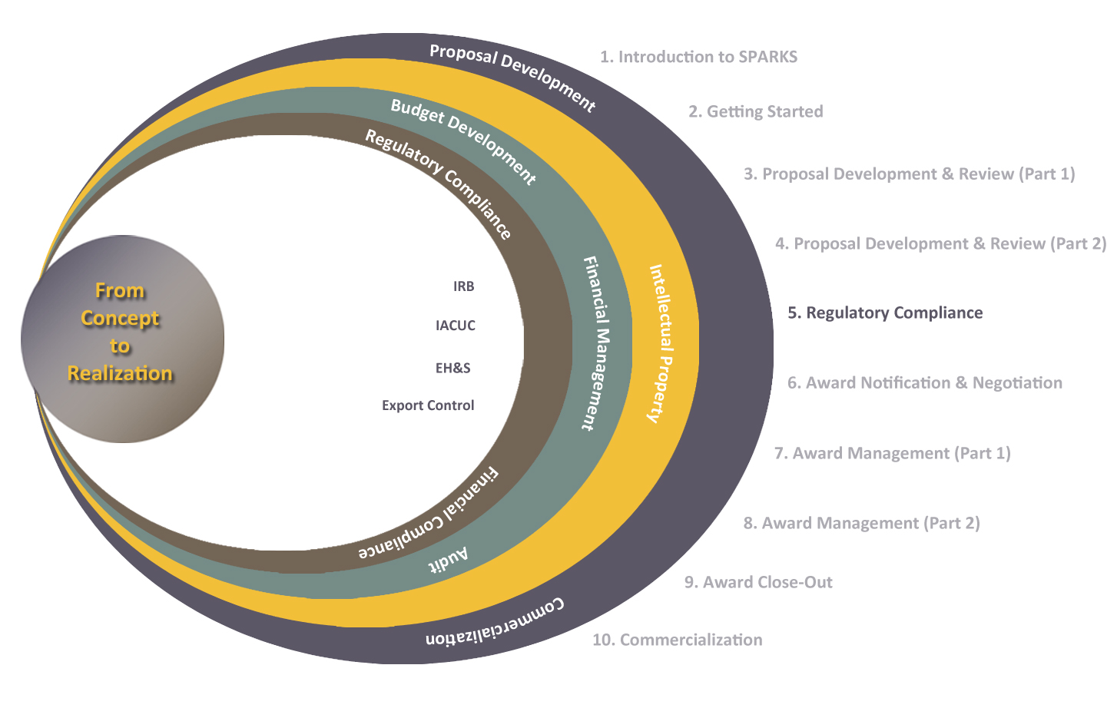
Exploring Research Administration from Concept to Commercialization

Slide 4
Exploring Research Administration from Concept to Commercialization
INSTITUTIONAL REVIEW BOARD
(IRB)
Joanne Muratori, Janice Turchin

Slide 5
Institutional Review Board
IRB
Research Involving Human Participants
University of Central Florida
Office of Research & Commercialization
407-823-2901 or fax 407-823-3299
www.research.ucf.edu/Compliance/irb.html
Regulatory Compliance

Slide 6
IRB Overview
Kendra Dimond Campbell, JD
IRB Interim Chair
IRB Office Staff:
Joanne Muratori, CIM
Janice Turchin, CIP
Billy Rippy, Assistant

Slide 7
IRB Function
The purpose of an IRB is to review research involving human subjects to ensure their rights and welfare are adequately protected.

Slide 8
Why Do Human Research Subjects Need Protection?
Trigger Events -The Nazi Experiments -Tuskegee Syphilis Study
Ethical Milestones -Nuremberg Code 1947 -National Commission for the Protection of Human -Subjects Biomedical & Behavioral 1974 -Belmont Report 1978 -Common Rule 1991

Slide 9
Ethical foundations
1974- Belmont Report
Represents 3 underlying principles
Respect for persons
Beneficence
Justice

Slide 10
Federal regulations
1974 National Research Act
1974- 45 CFR 46
1981- 45 CFR 46 revised, 21 CFR 50, 21 CFR 56
addresses consent and role of IRBs
1991- “The Common Rule”

Slide 11
Protective mechanisms established by “The Common Rule”
Institutional assurances of compliance
Review of research by an IRB
Informed consent of subjects

Slide 12
Institutional Assurance
UCF has negotiated with the Office for Human Research Protections that all of the institution’s human subject research activities, regardless of funding, will be guided by the Belmont Report, will comply with the Common Rule, and other regulations as applicable.
This is referred to as a
Federalwide Assurance (FWA).

Slide 13
Why is compliance important?
Professional ethics
Statute compliance
Publication
Individual grant funding
University grant funding
University research
Liability

Slide 14
UCF has received accreditation of its Human Research Protection Program
Accreditation by the Association for the Accreditation of Human Research Protection Programs, Inc. (AAHRPP) is the “gold standard” that signifies that UCF is in full compliance with regulatory requirements as well as industry best-practices.
Analogous to Association for Assessment and Accreditation of Laboratory Animal Care International (AAALAC International) accreditation for animal research.
Demonstrates commitment to human subject protections

Slide 15
AAHRPP accreditation offers benefits to researchers
Better standing in competition for funding.
Many foundations give preference to accredited institutions (CF, alpha1)
Recognition of importance by government and private sponsors
Required by VA, DOE
NIH intramural program beginning to work towards AAHRPP accreditation
Easier collaboration with other accredited organizations (i.e. Veterans Administration Hospitals)

Slide 16
How do I know if a project needs IRB review?
Meets federal definition of “research”
Systematic investigation designed to develop or contribute to generalizable knowledge
+
Meets definition of “human subject(s)”
The investigator will gather data about living individuals through intervention or interaction OR The investigator will gather data about living individuals that is private AND identifiable.

Slide 17
Criteria for IRB Approval
Risks are Minimized (Consistent with a sound research design and does not unnecessarily expose subjects to risk)
Risks are Reasonable in Relation to Benefits
Selection of Subjects is Equitable
Informed Consent will be Sought for Each Prospective Subject
Informed Consent will Be Documented
Research Plan Adequately Provides for Monitoring the Data Collected to Ensure Safety of the Subjects
Research Plan Adequately Protects the Privacy of Subjects and Maintains Confidentiality
When some or all of the subjects are likely to be vulnerable to coercion or undue influence, additional safeguards need to be included in the protocol to protect the rights and welfare of these subjects.

Slide 18
IRB Review of Research
All research projects are categorized into one of three categories for the IRB review process. Each category is different in the level of scrutiny and submission procedures. The IRB is responsible for making the final decision of which category a research project falls under.
Full Board Review
Expedited
Exempt

Slide 19
Levels of review- Expedited (reviewed by Chair or IRB designated member)
Minimal risk and fit into an “Expedited” category
Document review
Surveys or interviews
Collection of specimens
Routine noninvasive procedures

Slide 20
Minimal Risk Definition
Minimal risk is the probability and magnitude of physical or psychological harm that is normally encountered in the daily lives, or in the routine medical, dental, or psychological examination of healthy persons.

Slide 21
Full Board Protocol Review
Protocols which meet the definition of more than minimal risk
PI is invited to meeting to clarify IRB concerns
UCF IRB meets once a month

Slide 22
The IRB has the authority to:
Approve
Require modifications prior to approval
Table until major issues are clarified
Disapprove all research activities including proposed changes in previously approved human subject research.

Slide 23
Required Training
CITI online human subjects protection training is required every 3 years. Study will not be approved until all KSP are trained.
See the UCF IRB website for access

Slide 24

QUESTIONS ?

Slide 25
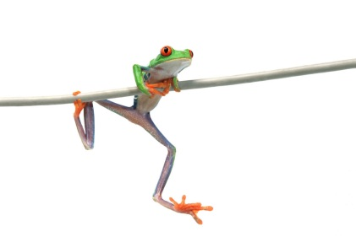
Exploring Research Administration from Concept to Commercialization
INSTITUTIONAL ANIMAL CARE AND USE COMMITTEE
(IACUC)
http://www.research.ucf.edu/Research/iacuc.html
Nancy Nisbett (for Cristina Caamano)

Slide 26
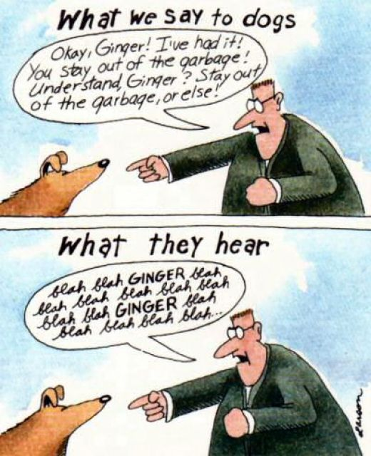
Regulatory Compliance

Slide 27
IACUC
Definition
Animal*: Any live, vertebrate animal used or intended for use in research, research training, experimentation, or biological testing or for related purposes.
* As defined by the Office of Laboratory Animal Welfare, National Institutes of Health
Regulatory Compliance

Slide 28
IACUC
Regulatory basis of the IACUC
Prior to 1966
Humane Societies
Pets
Farm Animals
Scientific Community
Animal care and well-being in the research laboratory
Regulatory Compliance
Notes:
28

Slide 29
IACUC
Regulatory basis of the IACUC
Legislation
Animal Welfare Act
The 1966 act set minimum standards for the handling, sale, and transport of cats, dogs, nonhuman primates, rabbits, hamsters, and guinea pigs held by animal dealers or pre-research in laboratories.
(USDA, latest November 2005)
Regulatory Compliance
Notes:
29

Slide 30
IACUC
Regulatory basis of the IACUC
Health Research Extension Act of 1985
PHS Policy (revised..85, 86 02)
NIH OLAW* FAQs, Notices, etc.
The Guide for the Care and Use of Laboratory Animals (8th edition, National Research Council, The National Academies)
NRC guide on Occupational Health & Safety (1997)
Ag Guide (1999) (agricultural animals used in research and teaching)
Animal Welfare Act Amended..85, 90, 02
USDA regulations 9 CFR, chapters 1,2,3
USDA animal care policies (1-29)
*Office of Laboratory Animal Welfare
Regulatory Compliance

Slide 31
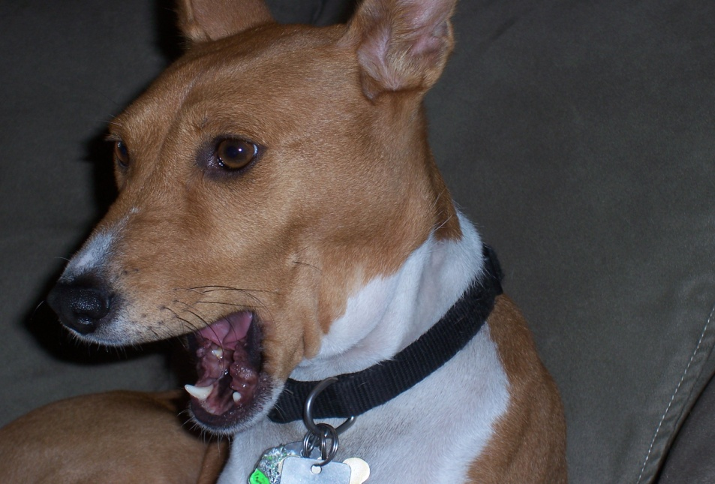
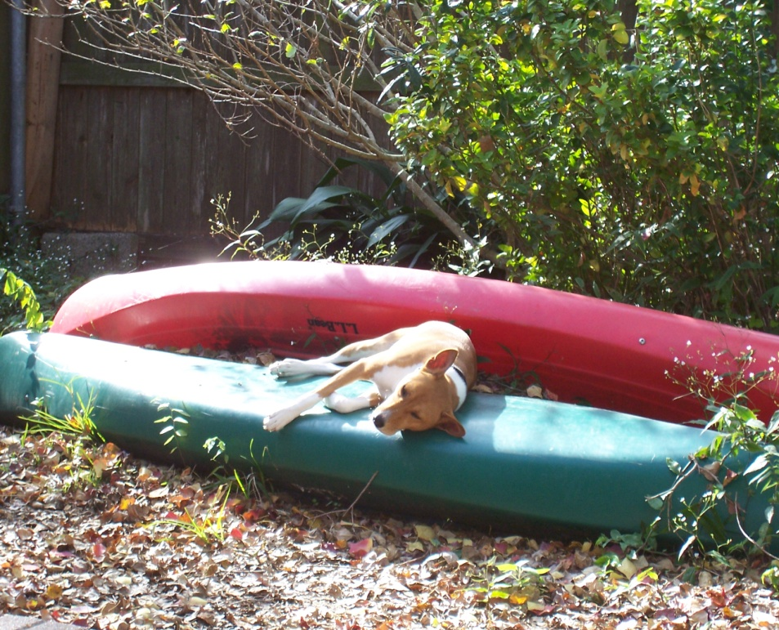
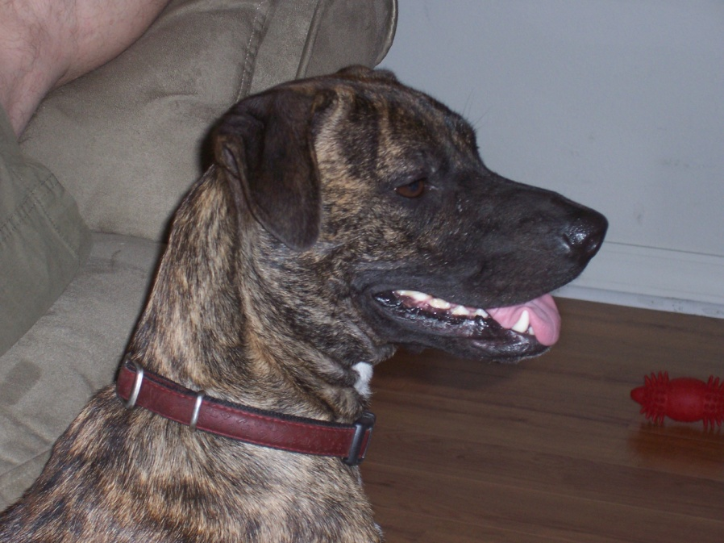
IACUC
Oh No!!! I’m worried!
Don’t Be.
It’ll be fine.
OK. I’ll chill.
Regulatory Compliance
Notes:
31

Slide 32
IACUC
Components of a Quality Animal Care and Use Program
Team
Institutional Official
Program Manager
Researchers
IACUC (the Committee)
Attending Vet
Animal Care Staff (and technical staff)
Policies, Procedures, Resources and Facilities
Regulatory Compliance

Slide 33
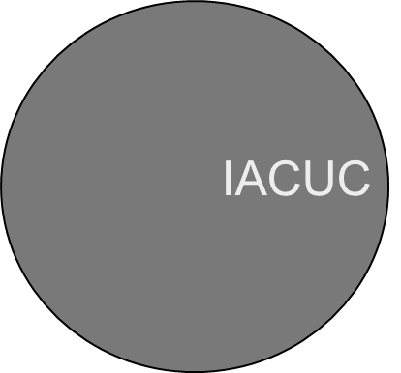

IACUC
Animal Care and Use Program Components
AV & Staff
IO &
Administration
Each component must make its contribution so that the whole is greater than the sum of the parts.
Investigator
Regulatory Compliance

Slide 34
IACUC
UCF’s Animal Care & Use Program Team
Institutional Official
Program Administration
Animal Facility Managers
IACUC Voting Members (11 - 3 DVMs)
IACUC Ex-Officio (non-voting) Members (7)
Regulatory Compliance

Slide 35
IACUC
What is an Institutional Animal Care and Use Committee?
Your Peers
At least 5 members
Chair
Attending Veterinarian
Scientist
Non-Scientist
Non-Affiliated Member
Regulatory Compliance

Slide 36
IACUC FUNCTIONS
Review the program of animal care –
every 6 months
Inspect the facilities - every 6 months
Report evaluations to IO
Investigate concerns
Make recommendations
Regulatory Compliance

Slide 37
IACUC FUNCTIONS
Review New Protocols
Review Modifications/Significant
Changes to Protocols
Suspend activities
Regulatory Compliance

Slide 38
IACUC RESPONSIBILITIES
IACUC Actions
Full Approval is given when the submitted protocol meets ALL of the committee’s requests and requirements.
Provisional Approval is a temporary approval in which the researcher is required to make minor changes to the protocol.
Regulatory Compliance

Slide 39
IACUC RESPONSIBILITIES
IACUC Actions
To Table or Withhold Approval is an option when a submission does not meet basic requirements or acceptable standards.
Suspension can occur when a researcher is found to be in serious violation of methods previously approved by the committee.
Regulatory Compliance

Slide 40
IACUC RESPONSIBILITIES
What are the methods of protocol review?
Only two methods for the review of protocols for:
Initial review
Significant changes
Continuing review
Full committee review
Designated member review
Approval of minor changes:
Administrative review
Regulatory Compliance

Slide 41
IACUC RESPONSIBILITIES
What are the differences?
Full Committee Review (FCR)
Convened meeting of a quorum (face to face)
May modify, approve or disapprove
Simple majority vote
If disapproved may not be approved administratively
Regulatory Compliance

Slide 42
IACUC RESPONSIBILITIES
What are the differences?
Designated Member Review (DMR)
One qualified member of the committee
Appointed by the Chair
May modify or approve the protocol
Unless any member of the committee requests a FCR
All members are provided with a list and description of all protocols and may request a FCR within a specified time period
Regulatory Compliance

Slide 43
IACUC
THE 3 “Rs”
Replacement, Reduction, Refinement
1. Replacement
Can non-animal models be used (mathematical or computer model)
In vitro models (tissue cultures)
2. Reduction
Minimize the number of animals to be used to the greatest extent possible
Maintain sound scientific and statistical standards
Regulatory Compliance

Slide 44
IACUC
THE 3 “Rs”
3. Refinement
Least amount of potential “PDDM”
Pain
Discomfort
Distress
Morbidity
Regulatory Compliance
Notes:
44

Slide 45
IACUC
AAALAC Accreditation
Association for Assessment and Accreditation of Laboratory Animal Care
Regulatory Compliance
Notes:
45

Slide 46
IACUC
Reporting concerns for animal welfare
All claims made will be taken seriously and investigated by the IACUC committee.
No individual shall be discriminated against or be subject to any reprisal for reporting violations of regulations or standard.
The University of Central Florida protects the rights of “whistle-blowers”.
Regulatory Compliance

Slide 47
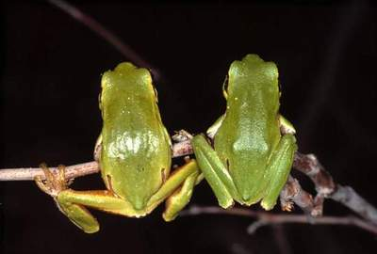
Questions?
? ? ? ? ? ? ? ?
Regulatory Compliance

Slide 48
Exploring Research Administration from Concept to Commercialization
ENVIRONMENTAL HEALTH & SAFETY
Laboratory and Research Support Services
Mr. Jose Vazquez,
Biosafety Coordinator
Mrs. Renea Carver,
Hazardous Materials/Radiation Control Coordinator

Slide 49
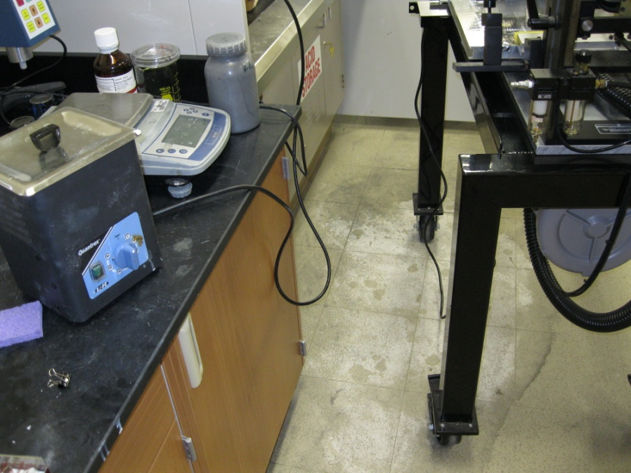
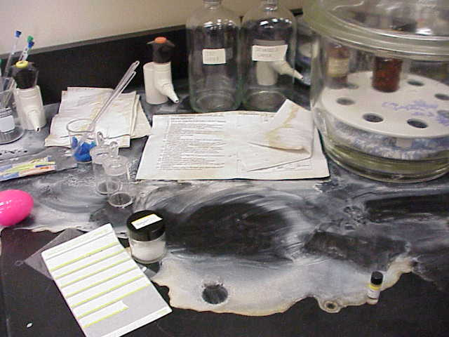
ENVIRONMENTAL HEALTH & SAFETY
3 GOALS
Health & Safety of UCF Community
Laboratory incidents
Cost Avoidance
Maintenance of assigned laboratory space
Compliance
Multiple regulatory agencies
Regulatory Compliance
Notes:
49

Slide 50
ENVIRONMENTAL HEALTH & SAFETY
PROGRAM AREAS
Insurance and Risk Management
Gift-In Kind Donations
Vehicles
Occupational Safety
Accident Investigation and Workers Compensation
Electrical Safety
LASERS
Respiratory Protection
PPE Stations
Building and Fire Code
Evacuation and Power-outage procedures
Permit required facility alterations
Laboratory and Environmental Support
Biological Safety
Regulatory Compliance
Notes:
50

Slide 51
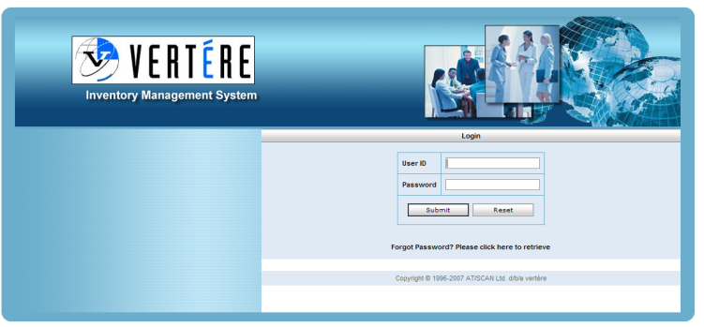
ENVIRONMENTAL HEALTH & SAFETY
Laboratory Safety
Lab Identification
Laboratory Hazard Signage
New lab assignments and close-outs
Research proposal review/permits
Training
Self-audit, “compliance assistance” meetings with individual labs.
Chemical Inventory
Items barcoded and entered online,
Consumed items “disposed” or “transferred”
Allows for sharing product through ReChem
CFATS, emergency response, etc.
Security
Regulatory Compliance
Notes:
51

Slide 52
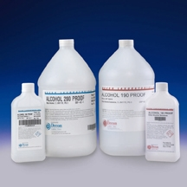

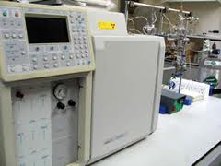
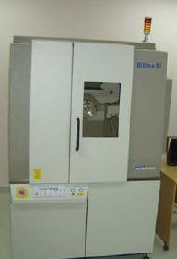

ENVIRONMENTAL HEALTH & SAFETY
Special Licenses/Issues
ATF
Explosives license
Tax-free alcohol permit
Florida Department of Health
Radioactive Materials (sealed and unsealed)
X-Ray generating equipment
Prescription Drugs
DEA-controlled substances
DOT/IATA
Shipping hazardous materials
Transporting hazardous materials
Regulatory Compliance
Notes:
52

Slide 53
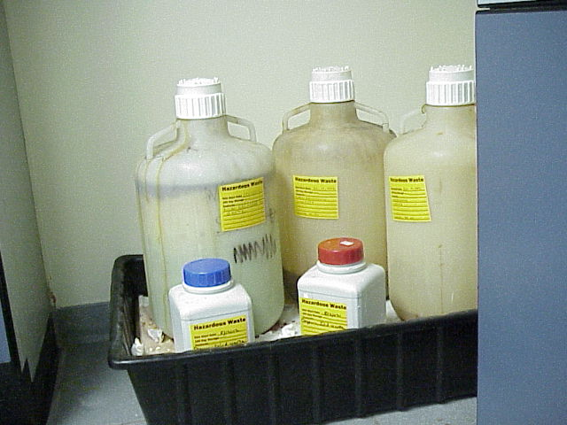
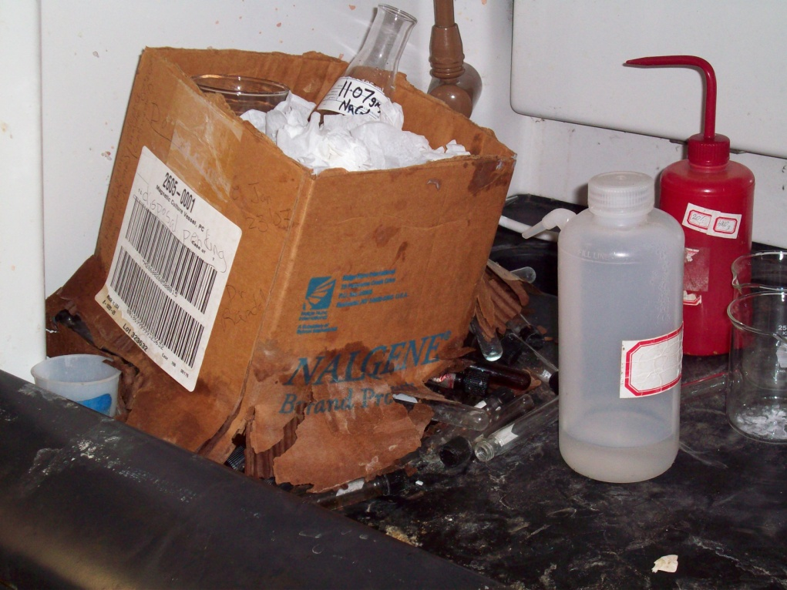
ENVIRONMENTAL HEALTH & SAFETY
Hazardous Waste
Labs responsible for
Identifying hazardous waste
Labeling, container selection, storage, waste requests.
Cleaning up incidental spills immediately.
EH&S responsible for
Training
Waste collection and disposal
54K FY 2009/2010
Emergency Response
After hours contact information
Regulatory Compliance
Notes:
53

Slide 54
ENVIRONMENTAL HEALTH & SAFETY
Biological Safety
Biosafety Levels
Laboratory Practice and Procedure
Safety Equipment
Laboratory Facilities
UCF Research
Institutional Biosafety Committee
Pathogenic agents
rDNA
Biosecurity
Regulatory Compliance
Notes:
54

Slide 55
ENVIRONMENTAL HEALTH & SAFETY
Questions?
www.ehs.ucf.edu
Regulatory Compliance
Notes:
55

Slide 56

Exploring Research Administration from Concept to Commercialization
EXPORT CONTROL
Mike Miller
Assistant Director for Export Controls

Slide 57
Export Control
Overview
Today we will talk about:
Export Control Basics
Identifiers
Exclusions
Impacts
Penalties
REGULATORY COMPLIANCE

Slide 58
Export Control
Federal Regulations governing the transmission of goods, materials, and information by whatever means out of the U.S. or within the U.S. to “foreign nationals.”
UCF cannot decide what is and is not controlled – its in the Regulations on various lists.
Can restrict shipments, exchanges of information, travel, and financial transactions.
Can restrict research collaborations, presentations, instruction outside the U.S., hiring certain foreign nationals to participate in certain research.
UCF website: http://www.research.ucf.edu/ExportControl/index.html
REGULATORY COMPLIANCE

Slide 59
Export Control
Basics
What is an export:
Transfer of listed “items” (EAR term), “articles” (ITAR term), or associated technical data by any means, including:
Shipping or carrying by person
Written/oral communications, digital transmissions
Deemed exports – release or transfer of technology or technical data to foreign persons in the U.S. (i.e. visual inspection or research participation)
Physical export NOT required
Transfer takes place in the U.S.
“Release” can include ANY access, i.e. computer access
Different standards for EAR and ITAR
REGULATORY COMPLIANCE

Slide 60
Export Control
Basics
Who is a foreign person/national:
Any person not a U.S. citizen or permanent resident (Green Card) or refugee / asylee
Any foreign corporation or other entity not incorporated in the U.S.
Any foreign government or entity (including foreign universities)
REGULATORY COMPLIANCE

Slide 61
Export Control
The Control Lists
Regulations with most impact on Higher Education (there are others):
State - International Traffic in Arms Regulations (ITAR) 22 CFR 120
Specifically designed, modified, adapted or configured for military or space application
United States Munitions List (USML)
Control Impacts: Extensive & Broad (articles, software & data)
Commerce - Export Administration Regulations (EAR) 15 CFR 738
Dual-use of purely commercial technologies
Commerce Control List (CCL)
Control Impacts: exceptions available, i.e Fundamental Research; “operation” is permitted
Requires case-by-case determination
REGULATORY COMPLIANCE

Slide 62
Export Control
The Control Lists
Treasury - Office of Foreign Assets Controls (OFAC) Regulations 31 CFR 500
Financial transactions, collaborations, or doing something
for a listed entity
The List: Designated Foreign Countries, Individuals and
Practices
Control Impacts: In addition to EAR & ITAR, prohibits
financial transactions
Faculty must be cognizant of what is on the control lists in your area! (You know the science better than anyone!)
REGULATORY COMPLIANCE

Slide 63
















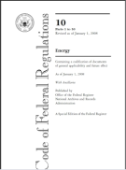





Regulatory Complexity
12 Federal Agencies plays a role in export control
Agency Export Arm Authority Regulations Enforcement Investigations
DoC
Census
Export Administration Act of 1969
15 CFR EAR
19 CFR (CBP)
DoJ
BIS
PTO
Office Export Enforcement
DoS
Threat Reduction
FBI
DSS
CIA
Arms Export Control Act of 1976
22 CFR ITAR
ODTC
DoD
DDTC
Operations
DDTC - Enforcement
Licensing
Executive Order 8389
Sanctions
DoT
Trading with Enemy Act
31 CFR
International Emergency Economic Powers Act
Various Statutes
DHS
OFAC
OFAC - Compliance
DoE
Energy Reorganization Act of 1974
10 CFR
CBP
ICE
(Enforcement)
NNSA Export Control
REGULATORY COMPLIANCE
Notes:
The U.S. Departments of State, Commerce, Homeland Security, Treasury, Defense, and Energy each play a critical role in export control and nonproliferation activities both within the United States and outside its borders.

Slide 64
Export Control
Primary Concern for Universities
Activities in the U.S. that exceed the “Deemed Export” threshold:
EAR:
Export of technology necessary for “Development, production or use” of CCL items
Operation, Installation, Maintenance, Repair, Overhaul AND Refurbishing
ALL 6 elements must be present to constitute “Use”
REGULATORY COMPLIANCE

Slide 65
Export Control
Primary Concern for Universities
Activities in the U.S. that exceed the “Deemed Export” threshold:
ITAR
Does not have “deemed export” threshold
Any access to any defense article is prohibited
Export of technical data in any form is considered transfer of “know how”
“Defense service” furnishing of assistance in the “design, development, engineering, manufacture, production, assembly, testing, repair, maintenance, modification, operation, demilitarization, destruction, processing or use”
REGULATORY COMPLIANCE

Slide 66
Export Control
Primary Concern for Universities
Activities in the U.S. that exceed the “Deemed Export” threshold:
Examples:
Technical training
Working with foreign persons, interns, or consultants
Collaborations, technical conversations
For EAR, access to controlled technology that involves all 6 elements
For ITAR, access in any form
REGULATORY COMPLIANCE

Slide 67
Export Control
Examples of Export Controlled “Stuff”
EAR:
Biology – Biological/chemical agents, pathogens (including zoonotic), microorganisms, toxins, and chemicals; vaccines and immunotoxins
AMPAC – samples of alloys, carbon ceramics, metal alloy powders, scanning electronic beam instruments, spectrometry instruments
CREOL – optical mirrors, imaging sensors, IR cameras, ruby lasers, tunable lasers
Siemens – Propulsion systems, power generators,
EHS – Protective clothing, suits,
Engineering – semiconductors, wafer equipment, chip design software
REGULATORY COMPLIANCE

Slide 68
Export Control
Examples of Export Controlled “Stuff”
ITAR
Most ITAR “stuff” at a university is in the form of technical data!!
Research data, research results, government furnished information, databases, etc.
Mock-ups/prototypes
UAV’s (underwater, air, or ground)
Certain thermal IR cameras
Military simulation software
High powered lasers
REGULATORY COMPLIANCE

Slide 69
Export Control
University Exclusions
Fundamental Research (ITAR vs. EAR)
Definition: (NSDD 189) / ITAR: (22 CFR §120.11(a)(8); Enacting: 22 CFR §125.1) / EAR:(15 CFR §734.8) Guidance: (15 CFR §734.11; 10 CFR §810.3; Enacting 15 CFR §734.2)
“Basic and applied research in science and engineering, the results of which ordinarily are published and shared broadly within the scientific community, as distinguished from proprietary research and from industrial development, design, production and product utilization the results of which ordinarily are restricted for proprietary or national security reasons.” National Security Decision Directive 189
No publications restrictions, access & dissemination restrictions on results.
Does not apply to tangible ITAR (USML) articles or proprietary technology / items
REGULATORY COMPLIANCE

Slide 70
Export Control
University Exclusions
Educational Information
ITAR: (22 CFR §120.11) / EAR: (15 CFR §734.9) & (15 CFR §734 Supplement No 1)
Applies when the information in question consists of general scientific, mathematical or engineering principles commonly taught in universities or information that is in the public domain, or conveyed in courses listed in course catalogues and their associated teaching labs of any academic institutions.
Public Domain
ITAR: (22 CFR §120.11) / EAR: (15 CFR §734.9) & (15 CFR §734 Supplement No 1)
Applies when the information is already in the public domain and does not have restrictions on who may access it (includes tour-groups)
REGULATORY COMPLIANCE

Slide 71
Export Control
“Restricted” Research
Restricted research is any type of research (sponsored or unsponsored), any award or agreement that has any restriction on:
Access
Dissemination
Publication
Participation
Otherwise operates to restrict participation in research and/or access to and disclosure of research results, i.e. “side deals” between investigators and sponsors
Activities that are not basic or applied research, i.e. technological development
REGULATORY COMPLIANCE

Slide 72
Export Control
“Restricted” Research
OR
Defense Research: ONR, DARPA, AFOSR, NASA, FAA, etc.
Defense research can be “fundamental” or “restricted.”
Foreign nationals can participate in “fundamental” – restricted requires licensing or exclusion.
Activities that “use” USML defense articles (as opposed to EAR items) are restricted
Providing technical instruction (know how) to a foreign national of “defense articles” via instruction, presentations, training, or consulting.
REGULATORY COMPLIANCE

Slide 73
Export Control
Impacts on Foreign Persons
Prohibitions against unlicensed participation:
PI may have to hire other participants (or)
Modify or curtail activities until license is obtained (or)
Obtain licenses (2-3+ months to process)
Government may deny license
Severe penalties (civil & criminal)
Attestation NOW mandatory per USCIS
http://www.research.ucf.edu/ExportControl/I-129.html
The main legal issue is ensuring a “deemed export” does not take place. The onus is on the Researcher
REGULATORY COMPLIANCE

Slide 74
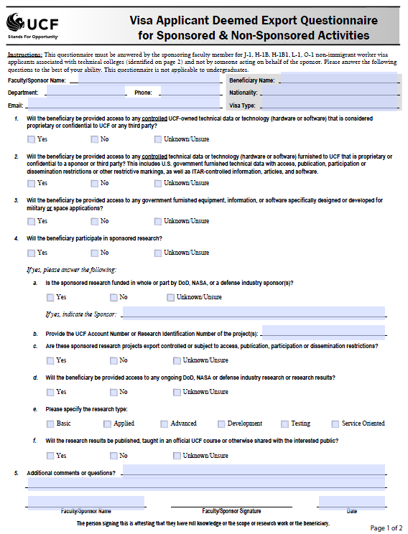
Export Control
Deemed Export Questionnaire
Who completes it:
Faculty Sponsor must complete because they are knowledgeable of what the applicant will do
H-1B, J-1, or other visitors
Accuracy is key
Sponsored Program Account Numbers is critical
Direct Sponsor to review export regs on website
http://www.research.ucf.edu/ExportControl/I-129.html
REGULATORY COMPLIANCE

Slide 75
Export Control
OFAC Sanctioned & Embargoed Countries
Countries:
Belarus
Burma
Cuba
Congo (Dem. Rep.)
Cote d’Ivoire
Iran
Iraq
Liberia
Libya
North Korea
Sudan
Syria
Zimbabwe
Types of Sanctions:
Comprehensive
Limited
Regime / List-Based
Primary Concerns:
Travel to an embargoed country
Export License Requirements
Furnishing financial assistance to restricted parties
Importing certain merchandise
Research or field work
UCF Website: http://www.research.ucf.edu/ExportControl/ofac.html
REGULATORY COMPLIANCE

Slide 76
Export Control
Penalties
Administrative Penalties (UCF)
Loss of funding/debarment
Loss of Export Privileges
Seizure, forfeiture of equipment
Extra compliance measures
Individual Penalties:
ITAR (22 CFR §127) (22 USC 2778(c))
Civil -- $500K per violation
Criminal -- $1M per violation / 10 years in prison
EAR (15 CFR §764.3(b))
Civil -- $250K fine per violation
Criminal -- $1M or 5x the value of the exports / 10 years in prison
REGULATORY COMPLIANCE

Slide 77
Export Control
Contact Information
Mike Miller Assistant Director for Export Controls
Office of Research & Commercialization
Office of Compliance University of Central Florida University Tower/Research Park 12201 Research Parkway, Suite 501 Orlando, FL 32826 Phone (407) 882-0660
Fax: (407) 823-3299 Email: mjmiller@mail.ucf.edu
UCF Export Compliance Website: http://www.research.ucf.edu/ExportControl
REGULATORY COMPLIANCE

Slide 78
THANKS FOR JOINING US!
Please come to the next session:
AWARD NOTIFICATION & NEGOTIATION
June 22, 2011
10:00 am – 12:00 pm
REGULATORY COMPLIANCE
June 8, 2011
10:00 am to 12:00 pm
Sponsored Programs Administration Resource & Knowledge Series
Regulatory Compliance

